Slide 1


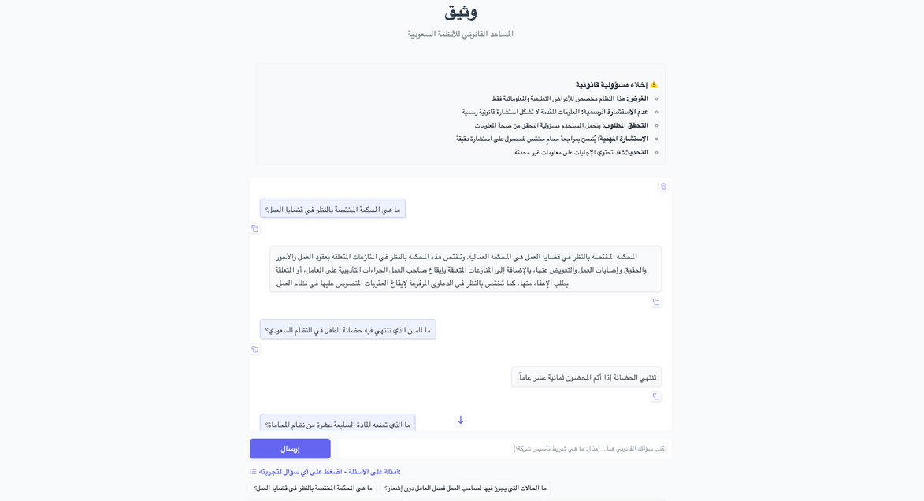

وَثيــــــــــق
Watheeq
Shahad Almutairi
Reem Alsahli
Taif Alharbi
Yasminah Alali

Slide 2
Project Overview
Watheeq is a legal assistant chatbot designed to simplify access to Saudi Arabian laws and regulations. Legal documents are often complex and difficult for the general public to interpret.
Watheeq helps users understand their rights and obligations by answering legal questions in clear, natural Arabic supporting Saudi Arabia’s digital transformation efforts.

Slide 3


Motivation Behind Watheeq
Complex Legal Language
Time-Consuming
Legal Research
Lack of Centralized
Access
Saudi laws are often written
in formal legal Arabic,
making them hard to
understand for non-specialists.
Finding relevant legal
information requires navigating long, unstructured documents.
There’s no unified tool that lets user ask legal questions and get reliable answers instantly.

Slide 4












Data Collection
We use unstructured text data sourced from the official website of هيئة الخبراء بمجلس الوزراء (Bureau of Experts), which publishes Saudi laws and regulations. The data includes the full legal texts of various systems (labor, personal status, business laws, etc.).
Complex Legal Language
Source
Unstructured
Web scraping
Processing
Official Saudi legal portal
Unstructured Arabic text
Web scraping using automated scripts
The scraped text is cleaned, categorized

Slide 5
Data Preprocessing
1. Load Legal Documents
We loaded our scraped legal data, which includes systems like Labor Law, Personal Status Law, and Law of Lawyers.
2. Split into Chunks
The documents were split into smaller text chunks for better context during search.
3. Create Embeddings
We used Cohere’s multilingual embedding model to convert each chunk into vector form.
4. Store in ChromaDB
All embeddings were saved into a Chroma vector database, ready for fast and accurate retrieval.
Saudi laws are often written
in formal legal Arabic,
making them hard to
understand for non-specialists.

Slide 6
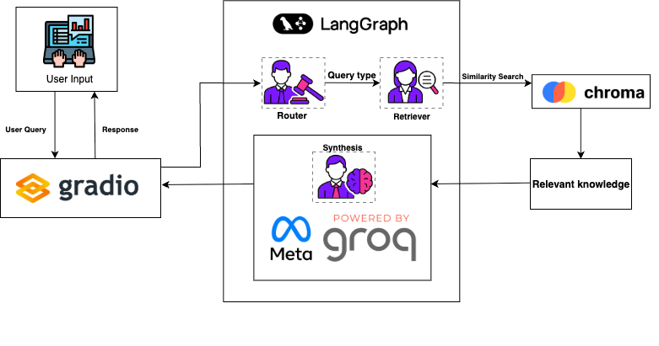
Architecture
Notes:
In this section, students will be tasked to learn more about the factors that play a part when choosing a LLM tool for a use-case. Give them a few minutes to explore those parts, and summarize with them :
Licensing :
Open Source LLMs (like those on GitHub): These offer advantages like transparency, customization, and potentially lower costs. However, they may require more technical expertise to set up and maintain, and might not perform as well as commercial options.
Commercial LLMs: These often provide user-friendly interfaces, superior performance, and ongoing support. The downside is that they typically come with licensing fees.
Model Size :
Different tasks require different model sizes. Smaller models are faster and have lower resource requirements, making them suitable for basic tasks or when data is limited.
Larger models tend to perform better on complex tasks that require understanding nuances and context. However, they can be computationally expensive and require significant training data.
come with licensing fees.
Performance :
Evaluating LLM performance involves various benchmarks and metrics. Here are a few examples:
Superglue: A suite of benchmarks assessing performance on multiple NLP tasks like reading comprehension and natural language inference.
HELM (Hierarchical Evaluation of Language Models): Measures an LLM's ability to follow instructions and complete multi-step tasks.
Offline evaluation allows you to test the LLM on your own dataset to see how well it performs on your specific use case.

Slide 7

LLM Selection
Primary Generation Model:
Groq LLaMA 3.3 (70B Versatile)
Delivers accurate, context-aware responses to Arabic legal queries
Optimized for fast, low-latency inference via Groq API
Temperature tuned to 0.3 for concise and factual answers
Router Model (for Query Classification):
Model: XLM-RoBERTa Large (XNLI)
Purpose:
Classifies user questions into categories (Labor Law, Commercial Law, Personal Status, Legal Procedures, etc.)
Ensures the system retrieves the most relevant documents before the LLM generates the answer
Provides a fallback keyword-based classifier for resilience
Notes:
In this section, students will be tasked to learn more about the factors that play a part when choosing a LLM tool for a use-case. Give them a few minutes to explore those parts, and summarize with them :
Licensing :
Open Source LLMs (like those on GitHub): These offer advantages like transparency, customization, and potentially lower costs. However, they may require more technical expertise to set up and maintain, and might not perform as well as commercial options.
Commercial LLMs: These often provide user-friendly interfaces, superior performance, and ongoing support. The downside is that they typically come with licensing fees.
Model Size :
Different tasks require different model sizes. Smaller models are faster and have lower resource requirements, making them suitable for basic tasks or when data is limited.
Larger models tend to perform better on complex tasks that require understanding nuances and context. However, they can be computationally expensive and require significant training data.
come with licensing fees.
Performance :
Evaluating LLM performance involves various benchmarks and metrics. Here are a few examples:
Superglue: A suite of benchmarks assessing performance on multiple NLP tasks like reading comprehension and natural language inference.
HELM (Hierarchical Evaluation of Language Models): Measures an LLM's ability to follow instructions and complete multi-step tasks.
Offline evaluation allows you to test the LLM on your own dataset to see how well it performs on your specific use case.

Slide 8
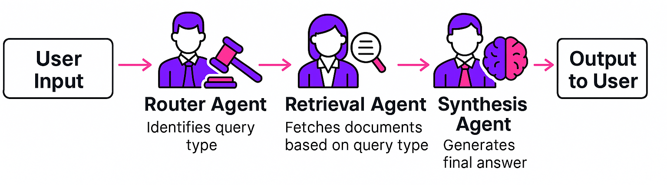
Multi-Agent Workflow
Notes:
In this section, students will be tasked to learn more about the factors that play a part when choosing a LLM tool for a use-case. Give them a few minutes to explore those parts, and summarize with them :
Licensing :
Open Source LLMs (like those on GitHub): These offer advantages like transparency, customization, and potentially lower costs. However, they may require more technical expertise to set up and maintain, and might not perform as well as commercial options.
Commercial LLMs: These often provide user-friendly interfaces, superior performance, and ongoing support. The downside is that they typically come with licensing fees.
Model Size :
Different tasks require different model sizes. Smaller models are faster and have lower resource requirements, making them suitable for basic tasks or when data is limited.
Larger models tend to perform better on complex tasks that require understanding nuances and context. However, they can be computationally expensive and require significant training data.
come with licensing fees.
Performance :
Evaluating LLM performance involves various benchmarks and metrics. Here are a few examples:
Superglue: A suite of benchmarks assessing performance on multiple NLP tasks like reading comprehension and natural language inference.
HELM (Hierarchical Evaluation of Language Models): Measures an LLM's ability to follow instructions and complete multi-step tasks.
Offline evaluation allows you to test the LLM on your own dataset to see how well it performs on your specific use case.

Slide 9
User Interface
Gradio (Custom-Styled)
RTL (Right-to-Left) Arabic support
Clean, mobile-friendly layout
Custom disclaimer and branding
Key UI Features:
Interactive Chatbot
Users can ask legal questions in both Arabic and English
Answers generated using retrieved laws
Preloaded Example Queries
Quick start for common legal topics (e.g., labor, commercial)
Disclaimer Box
Clarifies non-official advisory role
Notes:
In this section, students will be tasked to learn more about the factors that play a part when choosing a LLM tool for a use-case. Give them a few minutes to explore those parts, and summarize with them :
Licensing :
Open Source LLMs (like those on GitHub): These offer advantages like transparency, customization, and potentially lower costs. However, they may require more technical expertise to set up and maintain, and might not perform as well as commercial options.
Commercial LLMs: These often provide user-friendly interfaces, superior performance, and ongoing support. The downside is that they typically come with licensing fees.
Model Size :
Different tasks require different model sizes. Smaller models are faster and have lower resource requirements, making them suitable for basic tasks or when data is limited.
Larger models tend to perform better on complex tasks that require understanding nuances and context. However, they can be computationally expensive and require significant training data.
come with licensing fees.
Performance :
Evaluating LLM performance involves various benchmarks and metrics. Here are a few examples:
Superglue: A suite of benchmarks assessing performance on multiple NLP tasks like reading comprehension and natural language inference.
HELM (Hierarchical Evaluation of Language Models): Measures an LLM's ability to follow instructions and complete multi-step tasks.
Offline evaluation allows you to test the LLM on your own dataset to see how well it performs on your specific use case.

Slide 10
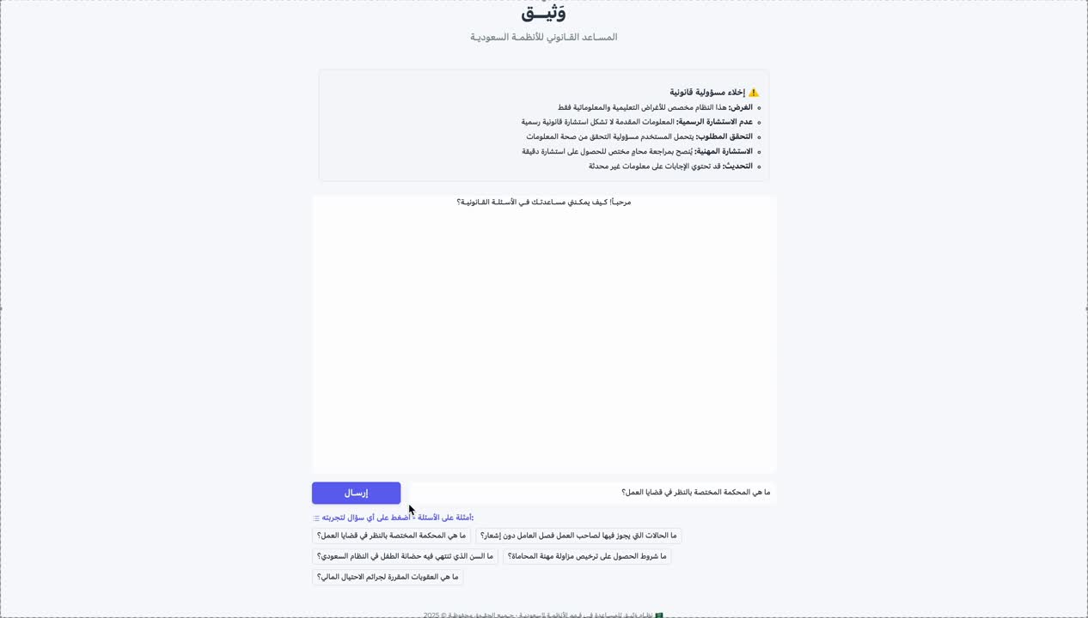
Demo
Notes:
In this section, students will be tasked to learn more about the factors that play a part when choosing a LLM tool for a use-case. Give them a few minutes to explore those parts, and summarize with them :
Licensing :
Open Source LLMs (like those on GitHub): These offer advantages like transparency, customization, and potentially lower costs. However, they may require more technical expertise to set up and maintain, and might not perform as well as commercial options.
Commercial LLMs: These often provide user-friendly interfaces, superior performance, and ongoing support. The downside is that they typically come with licensing fees.
Model Size :
Different tasks require different model sizes. Smaller models are faster and have lower resource requirements, making them suitable for basic tasks or when data is limited.
Larger models tend to perform better on complex tasks that require understanding nuances and context. However, they can be computationally expensive and require significant training data.
come with licensing fees.
Performance :
Evaluating LLM performance involves various benchmarks and metrics. Here are a few examples:
Superglue: A suite of benchmarks assessing performance on multiple NLP tasks like reading comprehension and natural language inference.
HELM (Hierarchical Evaluation of Language Models): Measures an LLM's ability to follow instructions and complete multi-step tasks.
Offline evaluation allows you to test the LLM on your own dataset to see how well it performs on your specific use case.

Slide 11
Evaluation
Evaluation Metric: LLM-as-Judge
Evaluate the accuracy of an LLM response by comparing it against the most relevant top documents retrieved for the user query.
Scoring Scale (0 to 1):
1.0 → Fully correct answer based on top documents
0.5 to 0.9 → Partially correct or mostly relevant
0.1 to 0.49 → Low relevance or mostly incorrect
0.0 → Completely unanswered or irrelevant
Saudi laws are often written
in formal legal Arabic,
making them hard to
understand for non-specialists.
Overall accuracy :0.91

Slide 12
Future Work
1. Comprehensive Extraction from هيئة الخبراء بمجلس الوزراء
Expand document coverage by extracting and structuring all available legal content and systems issued by the Bureau of Experts.
2. Improved Chunking Strategy
Refine document chunking techniques to preserve semantic coherence and improve retrieval accuracy especially for long legal texts and nested articles.
3. Support for More Legal Systems
Scale the pipeline to include additional systems and regulations beyond the current dataset
4. Advanced File Upload Handling
Improve parsing, validation, and pre-processing for uploaded legal PDFs, ensuring clean and accurate ingestion across various formats and layouts.
Saudi laws are often written
in formal legal Arabic,
making them hard to
understand for non-specialists.

Slide 13
Conclusion
Watheeq has successfully demonstrated accurate legal question answering based on six Saudi legal documents, delivering responses in clear and natural Arabic. It maintains high precision by avoiding hallucinations and refusing to answer questions beyond its supported scope, ensuring trustworthy interactions aligned with national legal standards. By simplifying complex legal language for the public, Watheeq contributes to broader legal accessibility and understanding.
Saudi laws are often written
in formal legal Arabic,
making them hard to
understand for non-specialists.

